Slide 1


JIAQING LI
Aug 22, 2022

Slide 2

Outline
Executive Summary
Introduction
Methodology
Results
Conclusion
Appendix

Slide 3
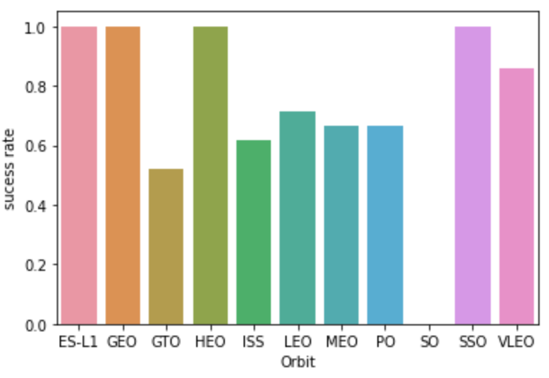
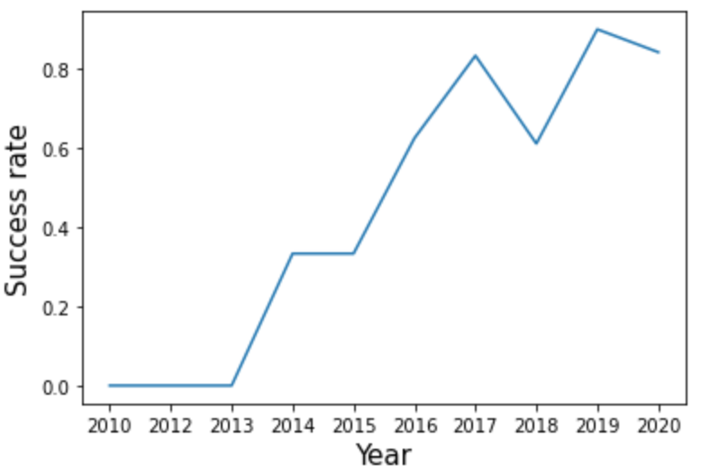
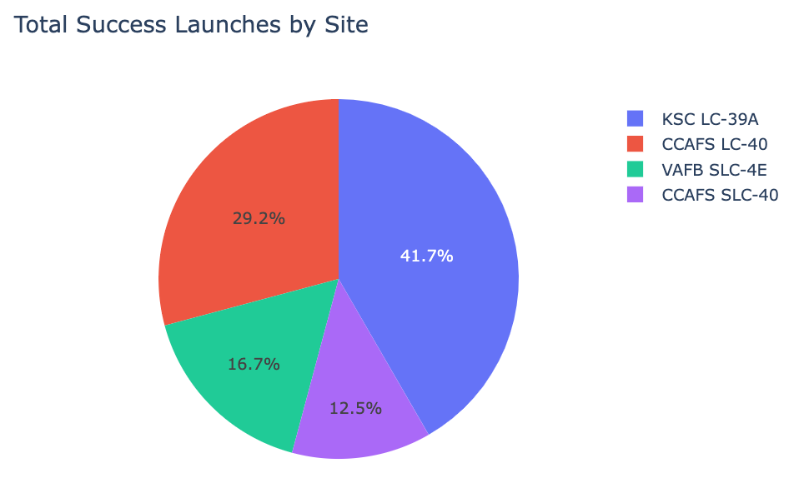
Executive Summary
We use data collection API to get SpaceX Data Sets
And use exploratory data analysis to analyze data and visualize data
Use Grid Search method to find the best Machine Learning Model to predict the classification of next landing

Slide 4
Introduction
Because SpaceX can reuse the first stage, SpaceX Falcon 9 rocket will launch with a cost of 62 million dollars; whereas other providers sometimes cost upward of 165 million dollars each.
So, if we can determine whether the first stage will land, we can determine the cost of a launch. This information can be used if an alternate company wants to bid against SpaceX for a rocket launch.
Can we predict a new launch with success of the first stage landing according to the historical launch data?
Can we tell what is the best choice for a successful launch?
Notes:
Project background and context
Problems you want to find answers

Slide 5

Section 1

Slide 6
Methodology
Executive Summary
Data collection methodology:
SpaceX REST API
Web Scraping (Wikipedia)
Perform data wrangling
Generate landing Class from Outcome column
Perform exploratory data analysis (EDA) using visualization and SQL
Perform interactive visual analytics using Folium and Plotly Dash
Perform predictive analysis using classification models
Using GridSearchCV to find best fit model

Slide 7
Data Collection
REST API
Web Scraping
SpaceX REST API
Wikipedia Page
JSON
HTML
DataFrame
DataFrame
Notes:
Describe how data sets were collected.
You need to present your data collection process use key phrases and flowcharts

Slide 8
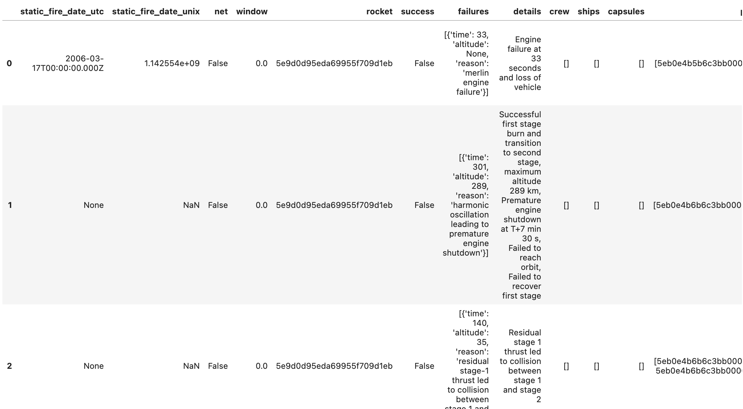
Data Collection – SpaceX API
SpaceX API repository https://github.com/r-spacex/SpaceX-API
Main Endpoint https://api.spacexdata.com/v4/launches/past
My Notebook https://github.com/lijqhs/ibm-data-science-capstone/blob/main/1-jupyter-labs-spacex-data-collection-api.ipynb
import requests
import pandas as pd
spacex_url = "https://api.spacexdata.com/v4/launches/past" response = requests.get(spacex_url) data = pd.json_normalize(response.json())
SpaceX REST API
JSON
DataFrame
Notes:
Present your data collection with SpaceX REST calls using key phrases and flowcharts
Add the GitHub URL of the completed SpaceX API calls notebook (must include completed code cell and outcome cell), as an external reference and peer-review purpose
Place your flowchart of SpaceX API calls here

Slide 9
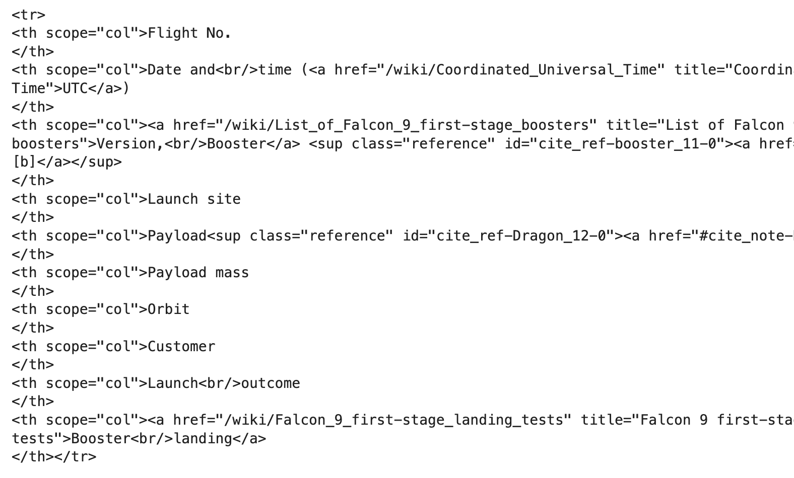
Data Collection - Scraping
Wikipedia Falcon Page https://en.wikipedia.org/wiki/List_of_Falcon_9_and_Falcon_Heavy_launches
My Notebook https://github.com/lijqhs/ibm-data-science-capstone/blob/main/2-jupyter-labs-webscraping.ipynb
import requests
from bs4 import BeautifulSoup url = 'https://en.wikipedia.org/wiki/List_of_Falcon_9_and_Falcon_Heavy_launches'
response = requests.get(url)
html_data = response.text
soup = BeautifulSoup(html_data)
Wikipedia Page
HTML
DataFrame

Slide 10
Data Wrangling
My Notebook https://github.com/lijqhs/ibm-data-science-capstone/blob/main/3-jupyter-spacex-data-wrangling.ipynb
Transform raw data to useful data. For example, convert original outcome labels into landing class that represent landing classification which will be our new landing prediction target.
1 for success
0 for failure
Original Outcome
Landing Class
True ASDS
None None
True RTLS
False ASDS
True Ocean
False Ocean
None ASDS
False RTLS
1
0
1
0
1
0
0
0
Notes:
Describe how data were processed
You need to present your data wrangling process using key phrases and flowcharts
Add the GitHub URL of your completed data wrangling related notebooks, as an external reference and peer-review purpose

Slide 11
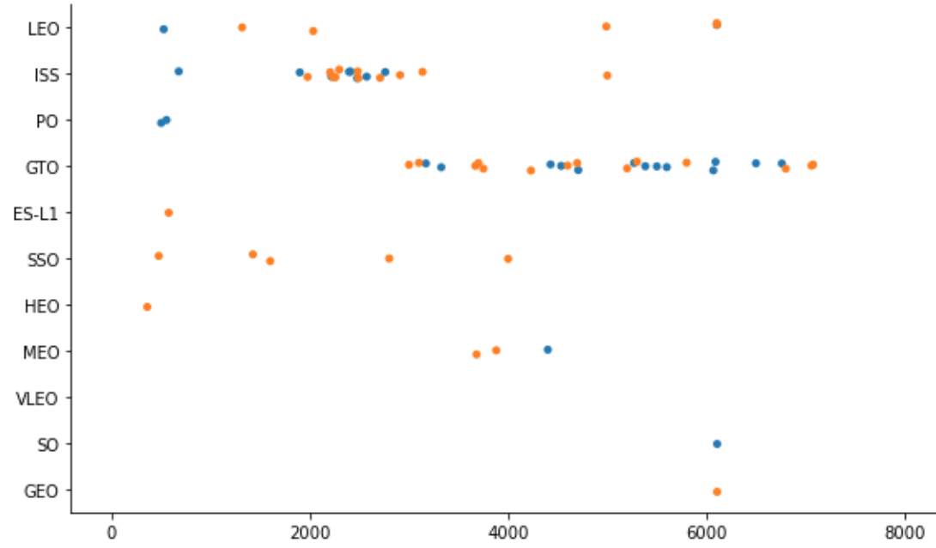

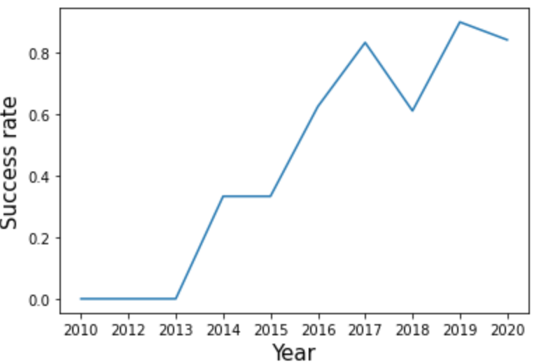
EDA with Data Visualization
My Visualization Notebook https://github.com/lijqhs/ibm-data-science-capstone/blob/main/5-jupyter-labs-eda-dataviz.ipynb
Scatter Plot | To get relationship between variables, e.g.: FlightNumber vs. Orbit type Payload vs. Orbit type FlightNumber vs. PayloadMass FlightNumber vs. Launch Site
Bar Plot | To plot success rate of each orbit
Line Chart | To get the yearly average launch success trend
Notes:
Summarize what charts were plotted and why you used those charts
Add the GitHub URL of your completed EDA with data visualization notebook, as an external reference and peer-review purpose

Slide 12
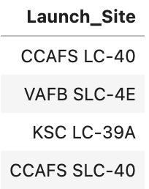
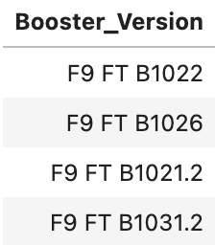
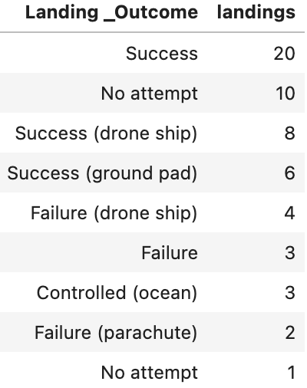
EDA with SQL
My SQL Notebook https://github.com/lijqhs/ibm-data-science-capstone/blob/main/4-jupyter-labs-eda-sql-coursera_sqllite.ipynb
%sql select distinct Launch_Site from SPACEXTBL
Query the names of the unique launch sites in the space mission
Query the names of the booster_versions which have carried the maximum payload mass.
List the total number of successful and failure mission outcomes
List the names of the boosters which have success in drone ship and have payload mass in some range
Rank the count of successful landing_outcomes in date range in descending order.
Notes:
Using bullet point format, summarize the SQL queries you performed
Add the GitHub URL of your completed EDA with SQL notebook, as an external reference and peer-review purpose

Slide 13
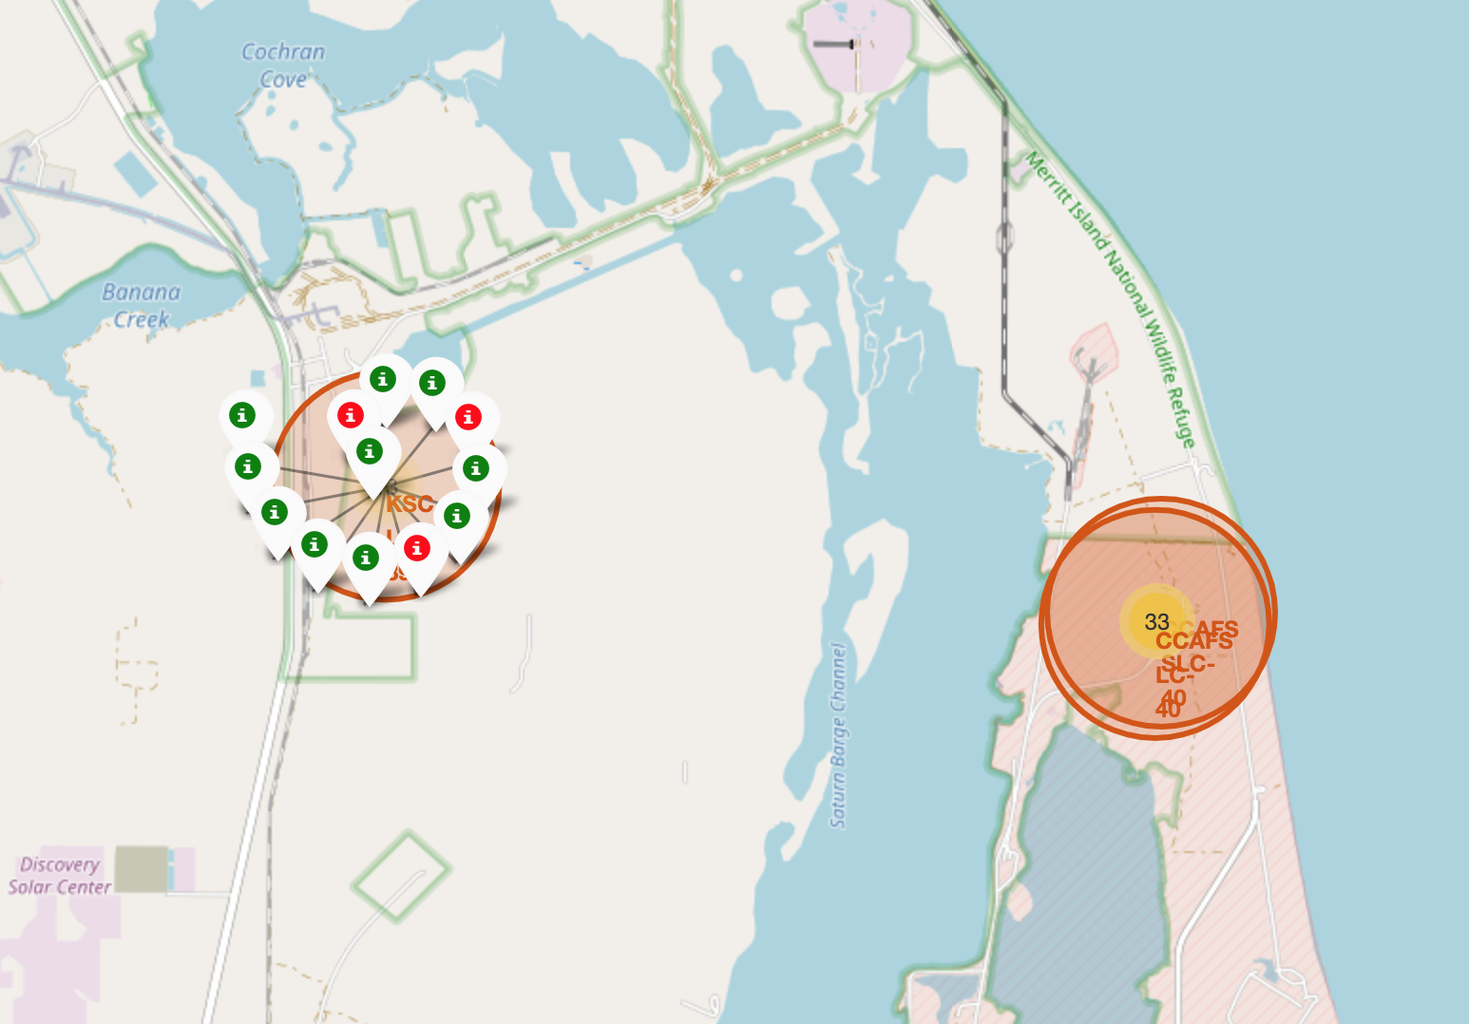
Build an Interactive Map with Folium
Add Circles for Launch sites and Markers for labels
Add MarkerCluster for successful and failed launches
Add Lines for calculate distance between launch sites and their proximities
My Notebook
https://github.com/lijqhs/ibm-data-science-capstone/blob/main/6-jupyter_launch_site_location_folium.ipynb
Notes:
Summarize what map objects such as markers, circles, lines, etc. you created and added to a folium map
Explain why you added those objects
Add the GitHub URL of your completed interactive map with Folium map, as an external reference and peer-review purpose

Slide 14
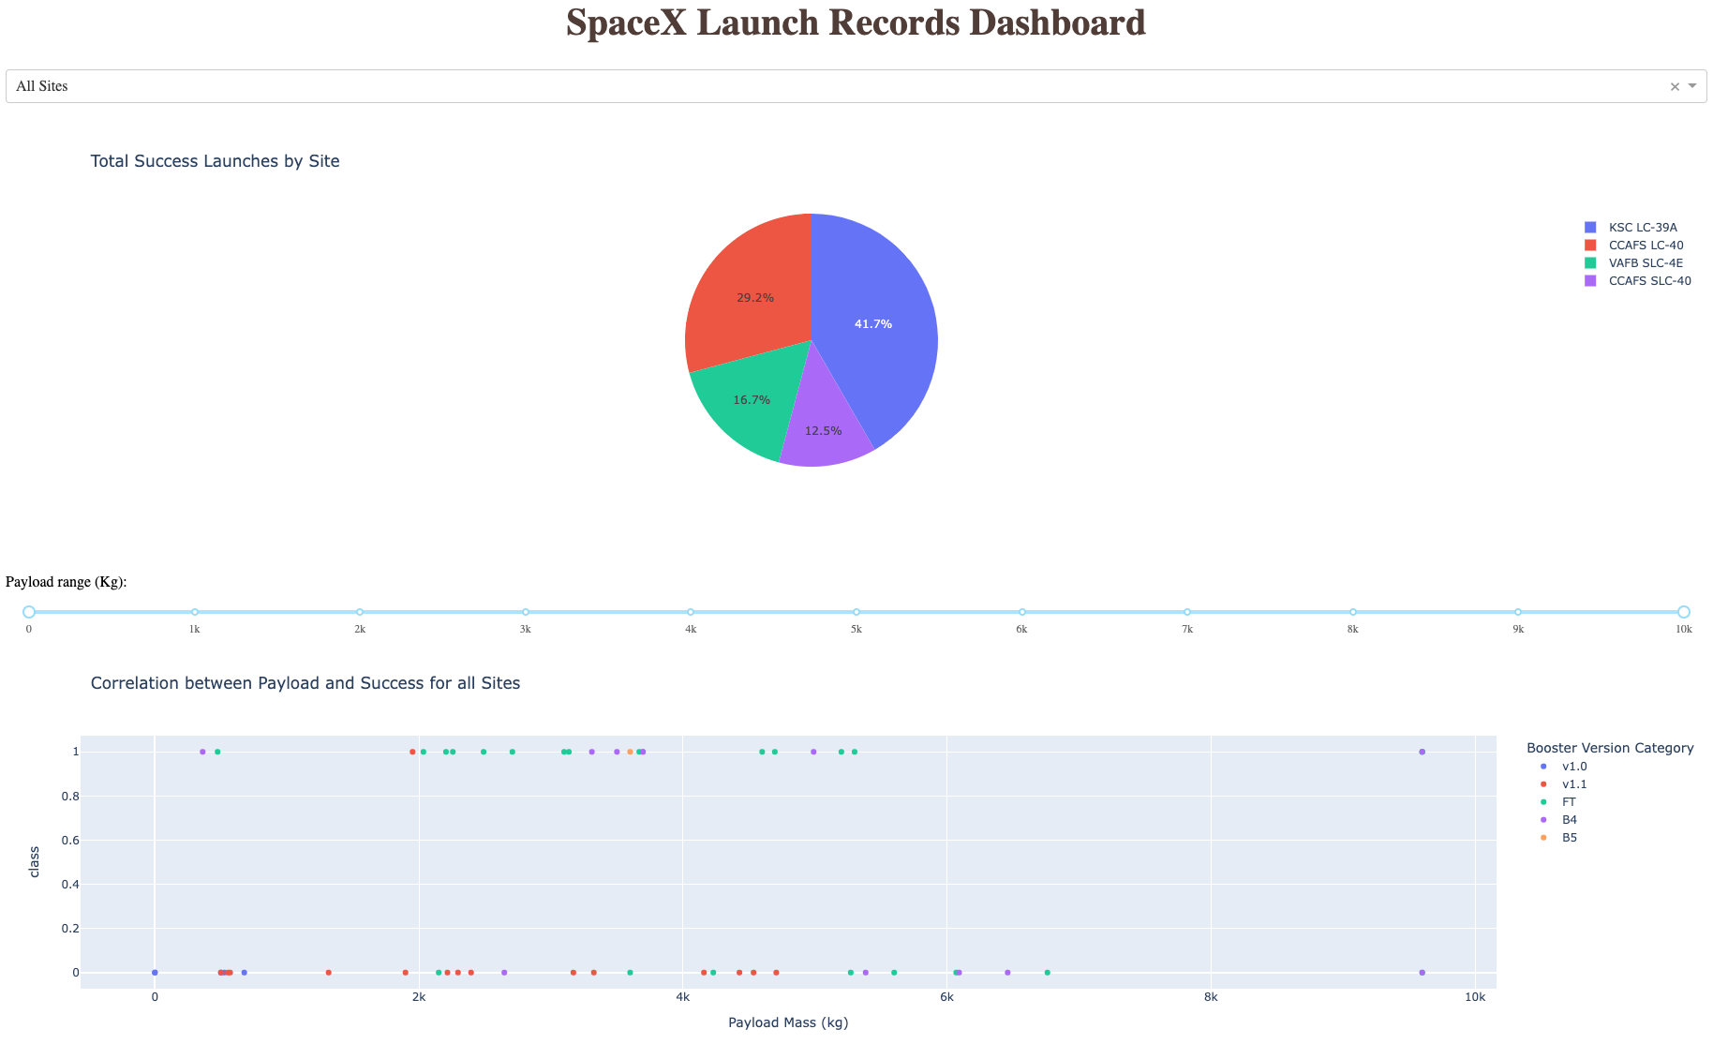
Build a Dashboard with Plotly Dash
With a Dropdown menu and a Pie Chart, we can get success launches distribution by launch site
Additionally, with a Range Slider and a Scatter Plot, we can analyze the correlation between Payload and Success for different launch sites
My Dashboard Python Code
https://github.com/lijqhs/ibm-data-science-capstone/blob/main/spacex_dash_app.py
Notes:
Summarize what plots/graphs and interactions you have added to a dashboard
Explain why you added those plots and interactions
Add the GitHub URL of your completed Plotly Dash lab, as an external reference and peer-review purpose

Slide 15
Predictive Analysis (Classification)
Prepare data
Create a column for the class
Standardize the data
Split into training data and test data
Define model and parameters
Train and Grid Search for best parameters
Evaluation
Preprocess Data
Define Model
Train Model
Evaluate Model
Data Cleaning
Choose Model
Tune Model
Accuracy Analysis
Data Transformation
Model Parameters
Grid Search
Model Plot
Dataset Splitting
My Notebook
https://github.com/lijqhs/ibm-data-science-capstone/blob/main/7-SpaceX_Machine_Learning_Prediction_Part_5.ipynb
Notes:
Summarize how you built, evaluated, improved, and found the best performing classification model
You need present your model development process using key phrases and flowchart
Add the GitHub URL of your completed predictive analysis lab, as an external reference and peer-review purpose

Slide 16
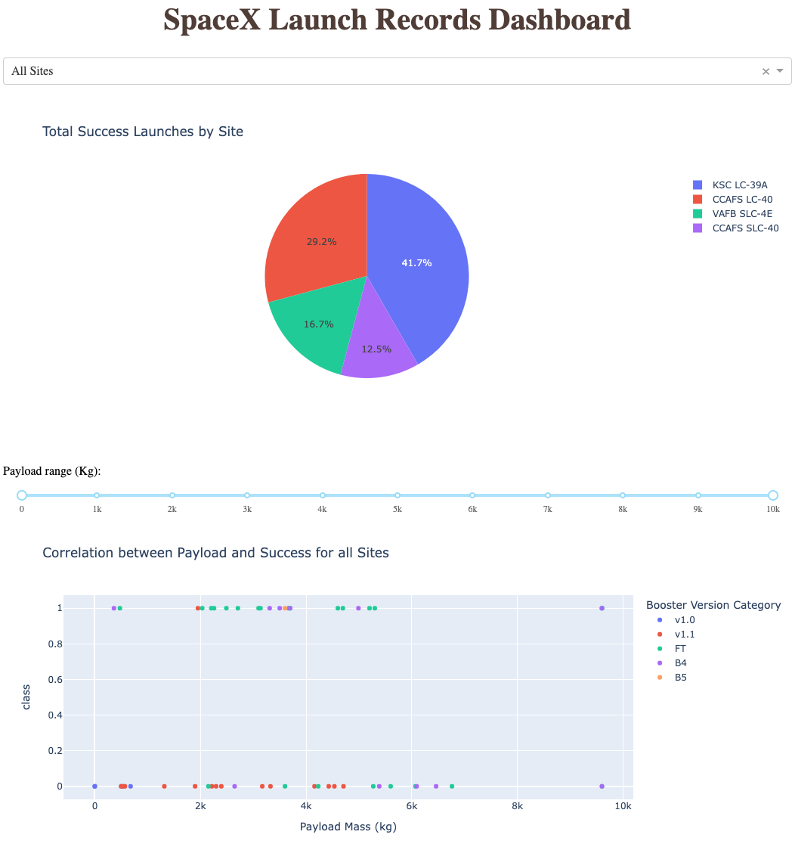
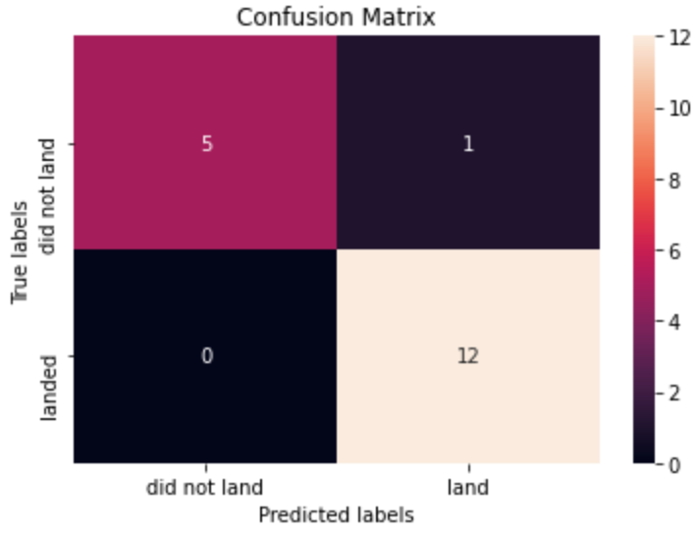
Results
Notes:
Exploratory data analysis results
Interactive analytics demo in screenshots
Predictive analysis results

Slide 17

Section 2

Slide 18
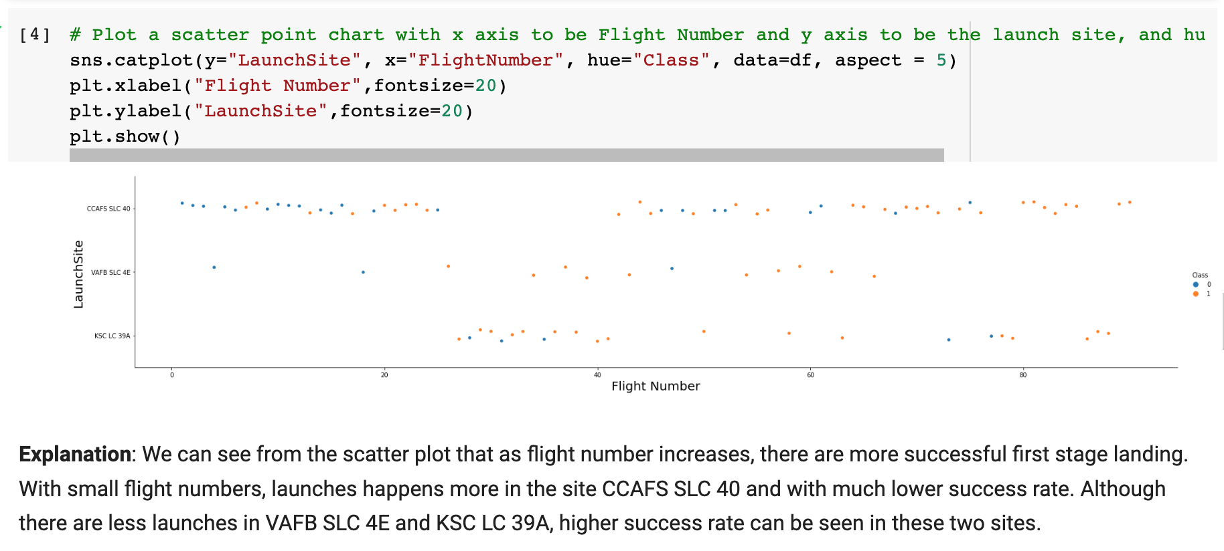
Flight Number vs. Launch Site
Notes:
Show a scatter plot of Flight Number vs. Launch Site
Show the screenshot of the scatter plot with explanations

Slide 19
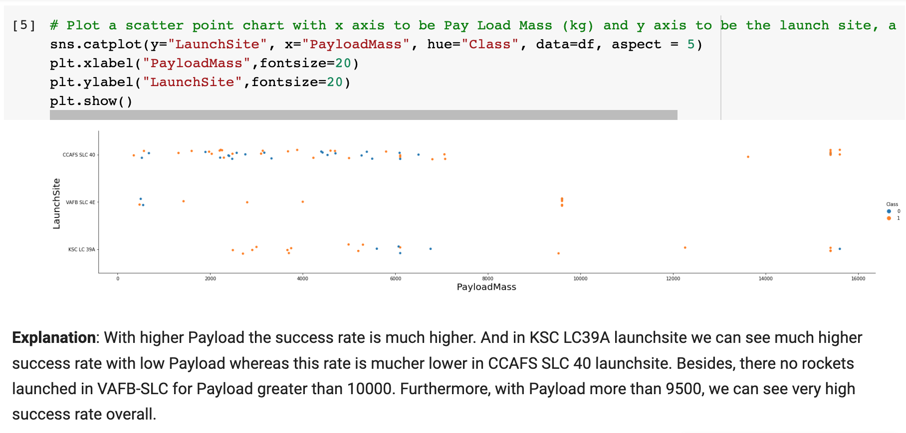
Payload vs. Launch Site
Notes:
Show a scatter plot of Payload vs. Launch Site
Show the screenshot of the scatter plot with explanations

Slide 20
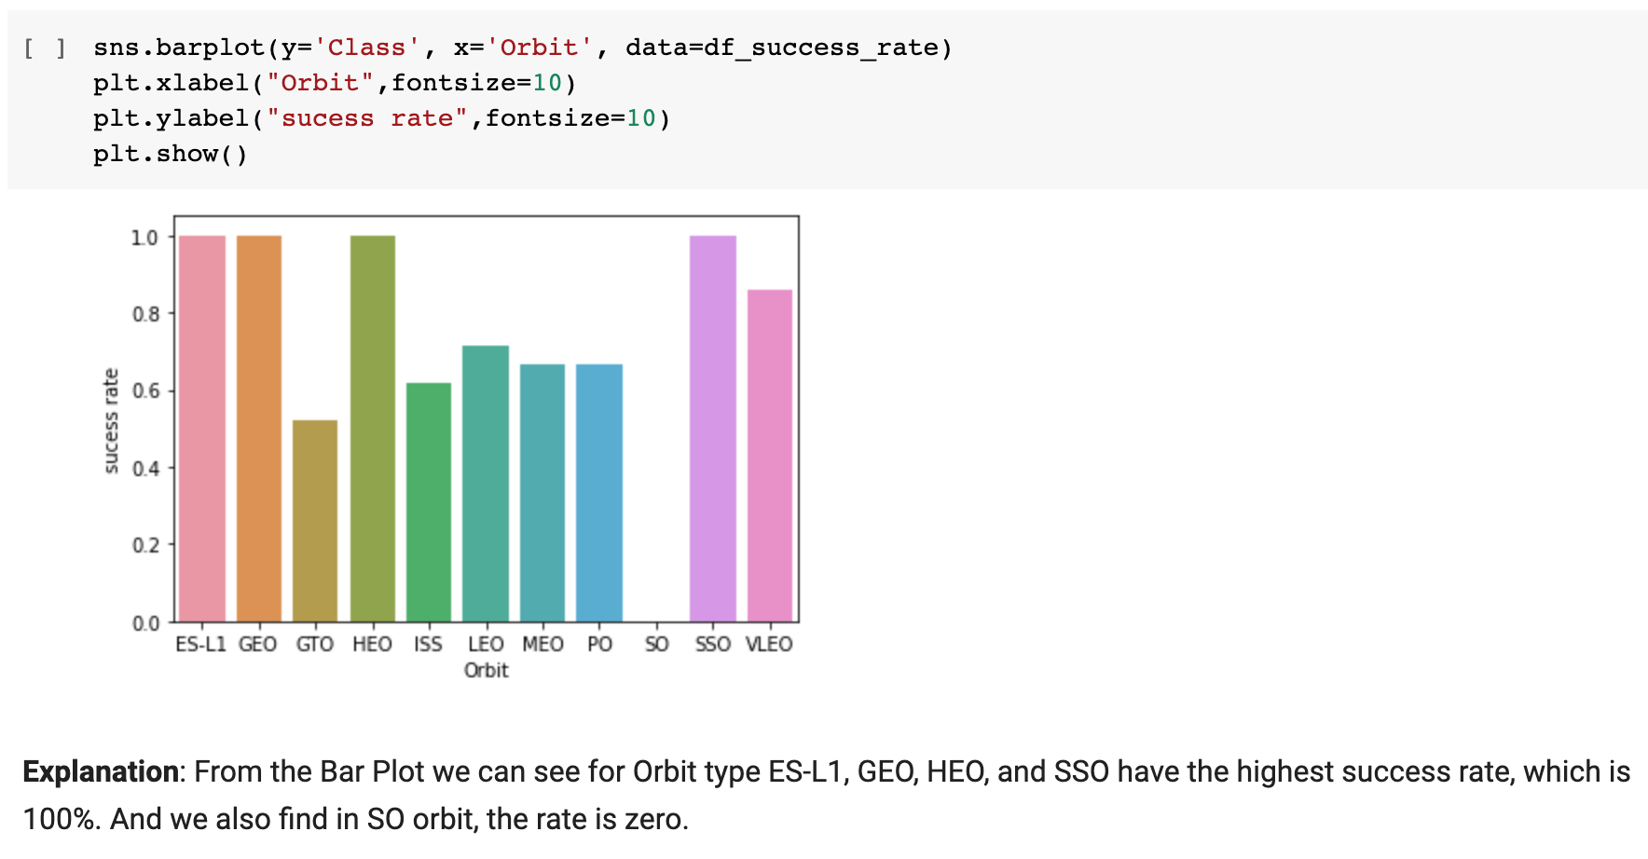
Success Rate vs. Orbit Type
Notes:
Show a bar chart for the success rate of each orbit type
Show the screenshot of the scatter plot with explanations

Slide 21
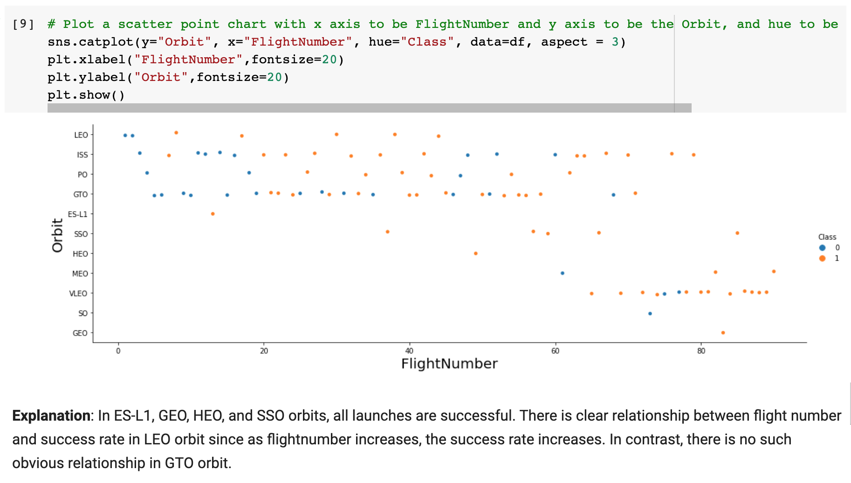
Flight Number vs. Orbit Type
Notes:
Show a scatter point of Flight number vs. Orbit type
Show the screenshot of the scatter plot with explanations

Slide 22
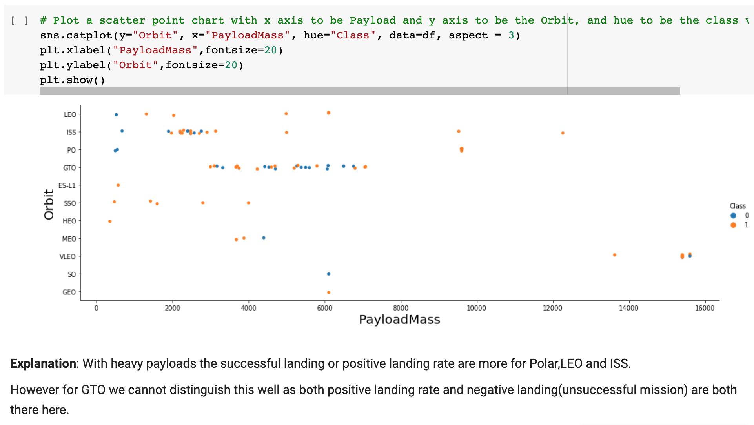
Payload vs. Orbit Type
Notes:
Show a scatter point of payload vs. orbit type
Show the screenshot of the scatter plot with explanations

Slide 23
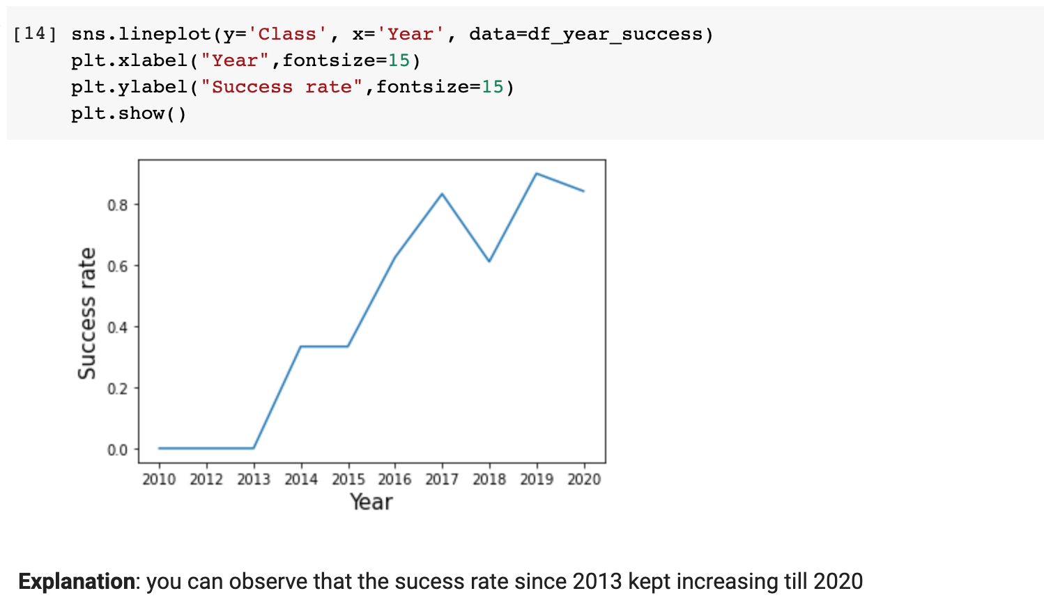
Launch Success Yearly Trend
Notes:
Show a line chart of yearly average success rate
Show the screenshot of the scatter plot with explanations

Slide 24
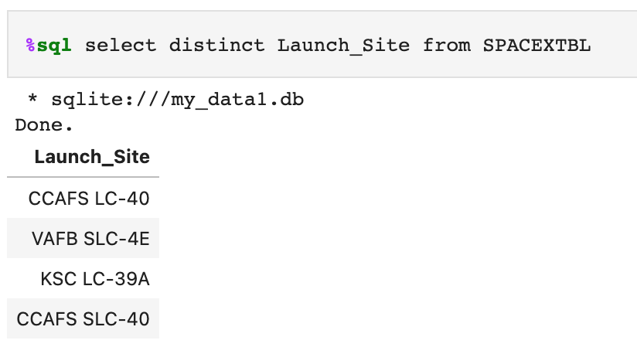
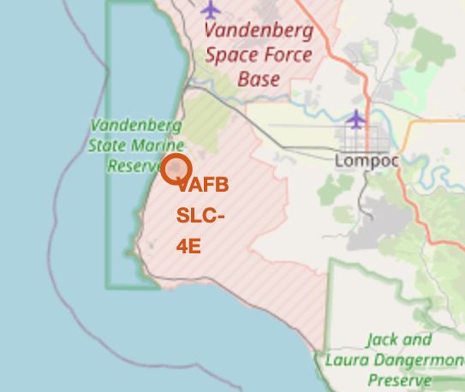
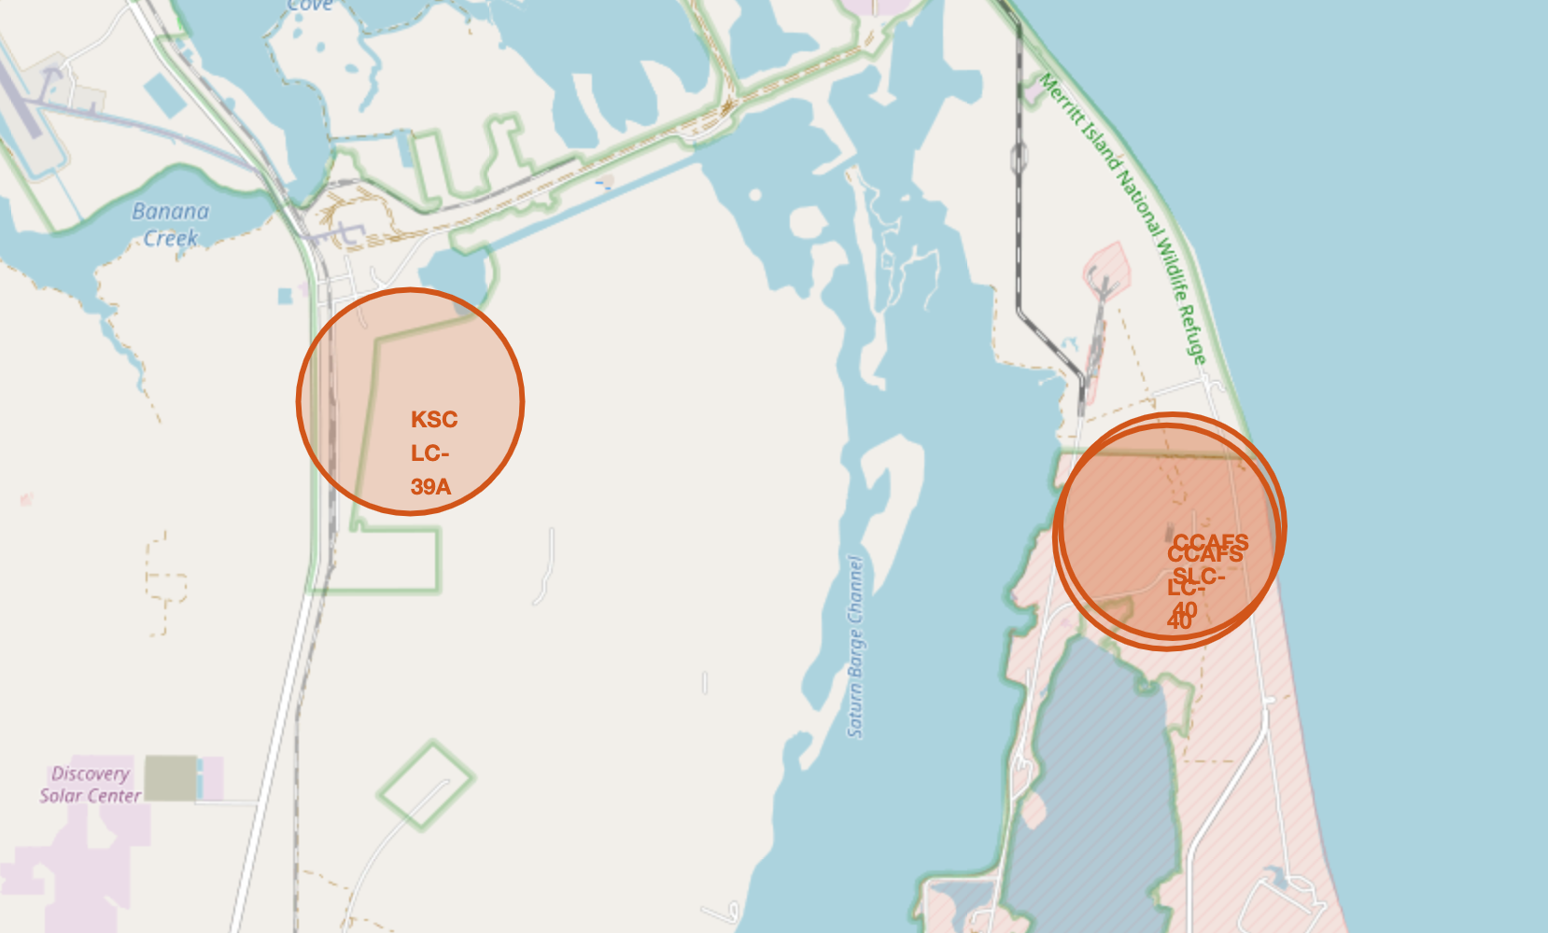
All Launch Site Names
Four Launch Sites:
CCAFS LC-40
VAFB SLC-4E
KSC LC-39A
CCAFS SLC-40
1 in western coast
VAFB SLC-4E
3 in eastern coast
KSC LC-39A
CCAFS SLC-40
CCAFS LC-40
Notes:
Find the names of the unique launch sites
Present your query result with a short explanation here

Slide 25
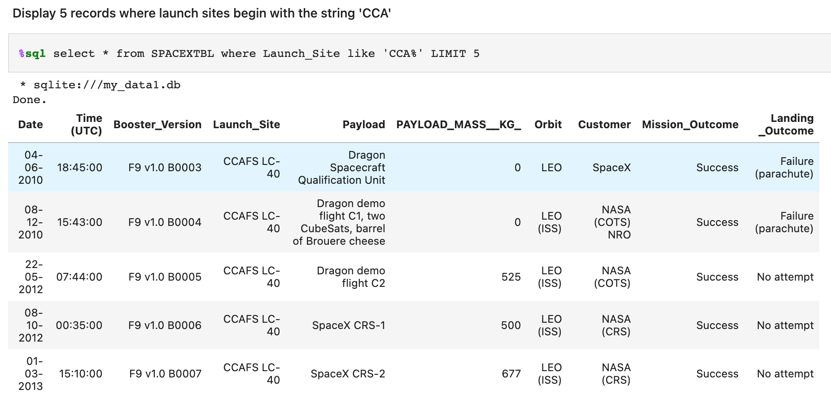
Launch Site Names Begin with 'CCA'
Explanation: these 5 launches happened in LEO orbit, and four of them were from customer NASA.
Notes:
Find 5 records where launch sites begin with `CCA`
Present your query result with a short explanation here

Slide 26
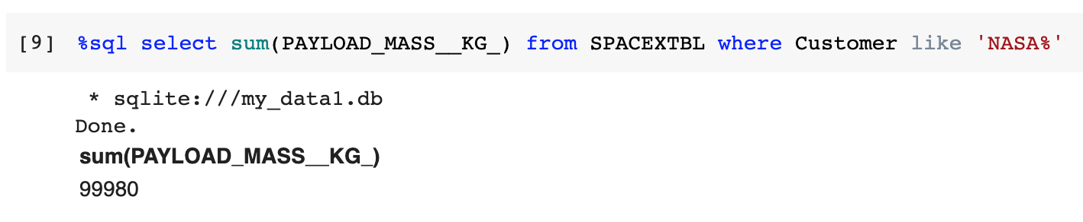
Total Payload Mass
Explanation: The total payload carried by boosters from NASA is 99980.
Notes:
Calculate the total payload carried by boosters from NASA
Present your query result with a short explanation here

Slide 27
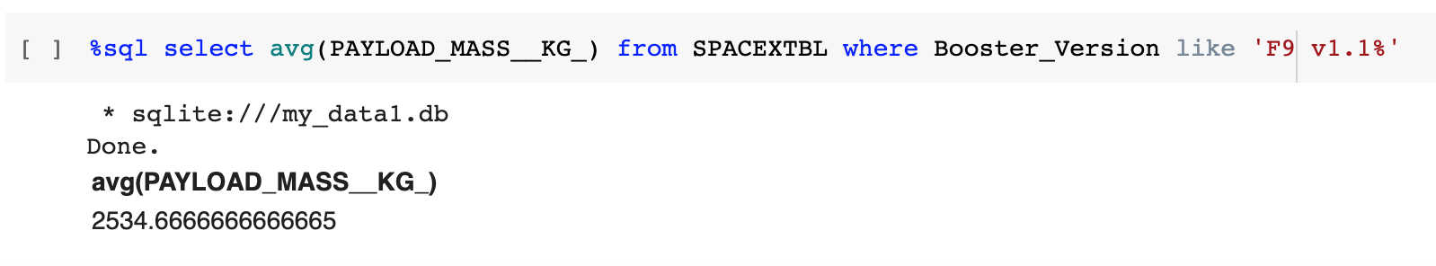
Average Payload Mass by F9 v1.1
Explanation: the average payload mass carried by booster version F9 v1.1 is 2534.67.
Notes:
Calculate the average payload mass carried by booster version F9 v1.1
Present your query result with a short explanation here

Slide 28
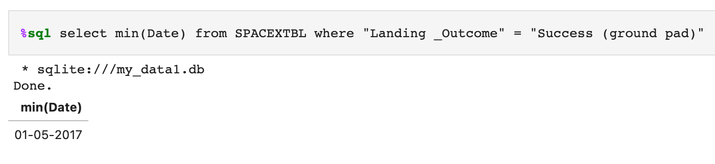
First Successful Ground Landing Date
Explanation: the first successful landing outcome on ground pad is 01-05-2017.
Notes:
Find the dates of the first successful landing outcome on ground pad
Present your query result with a short explanation here

Slide 29
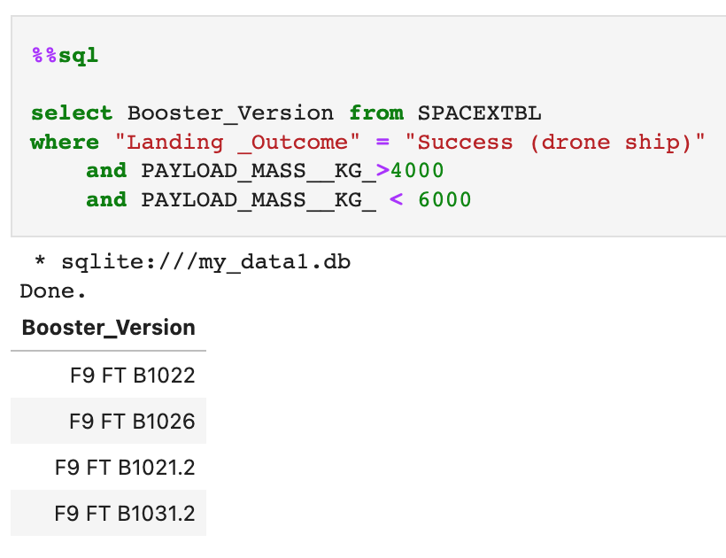
Successful Drone Ship Landing with Payload between 4000 and 6000
Explanation: names of boosters which have successfully landed on drone ship and had payload mass greater than 4000 but less than 6000
F9 FT B1022
F9 FT B1026
F9 FT B1021.2
F9 FT B1031.2
Notes:
List the names of boosters which have successfully landed on drone ship and had payload mass greater than 4000 but less than 6000
Present your query result with a short explanation here

Slide 30
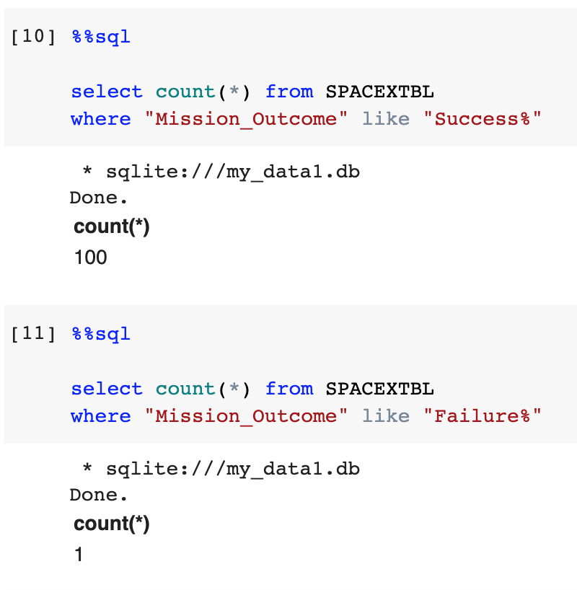
Total Number of Successful and Failure Mission Outcomes
Explanation:
the total number of successful mission outcomes is 100
the total number of failure mission outcomes is 1
Notes:
Calculate the total number of successful and failure mission outcomes
Present your query result with a short explanation here

Slide 31
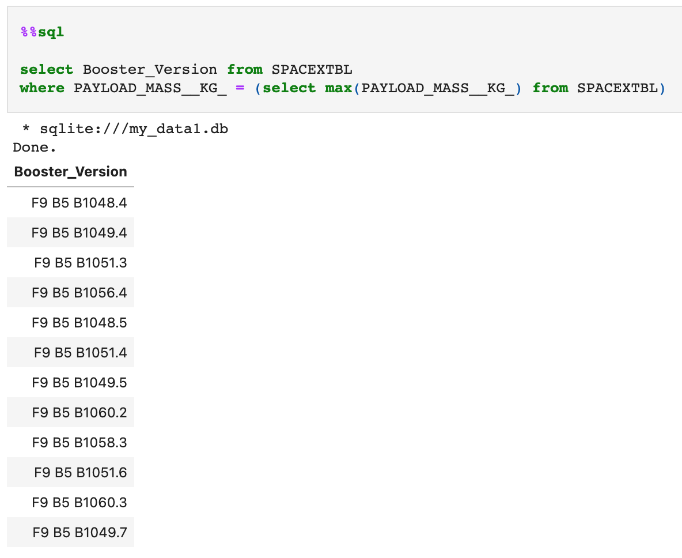
Boosters Carried Maximum Payload
Names of the booster which have carried the maximum payload mass:
F9 B5 B1048.4
F9 B5 B1049.4
F9 B5 B1051.3
F9 B5 B1056.4
F9 B5 B1048.5
F9 B5 B1051.4
F9 B5 B1049.5
F9 B5 B1060.2
F9 B5 B1058.3
F9 B5 B1051.6
F9 B5 B1060.3
F9 B5 B1049.7
Notes:
List the names of the booster which have carried the maximum payload mass
Present your query result with a short explanation here

Slide 32
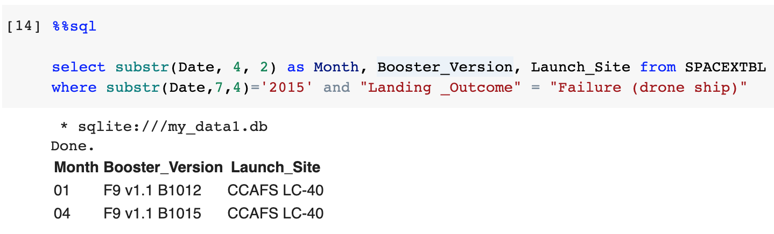
2015 Launch Records
Failed landing_outcomes in drone ship, their booster versions, and launch site names for in year 2015:
Month | Booster_Version | Launch_Site
01 | F9 v1.1 B1012 | CCAFS LC-40
04 | F9 v1.1 B1015 | CCAFS LC-40
Notes:
List the failed landing_outcomes in drone ship, their booster versions, and launch site names for in year 2015
Present your query result with a short explanation here

Slide 33
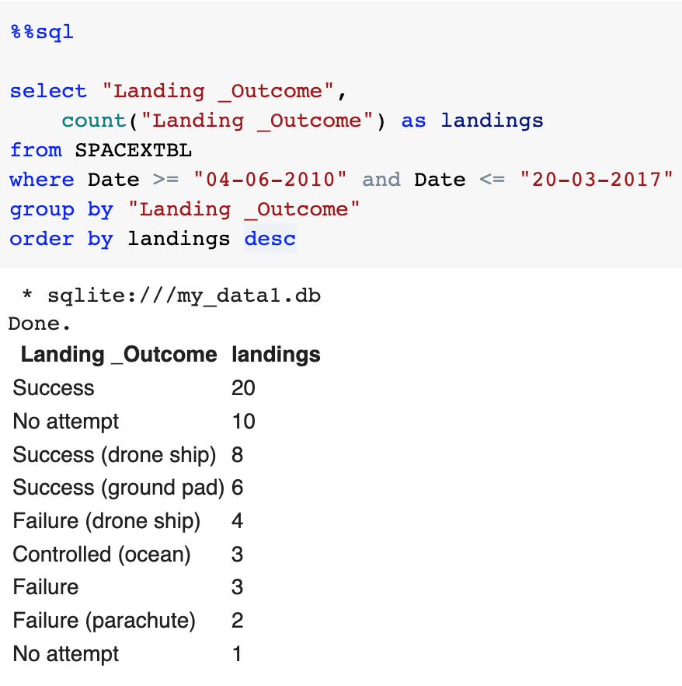
Rank Landing Outcomes Between 2010-06-04 and 2017-03-20
Rank the count of landing outcomes between the date 2010-06-04 and 2017-03-20:
Landing _Outcome | landings
Success | 20
No attempt | 10
Success (drone ship) | 8
Success (ground pad) | 6
Failure (drone ship) | 4
Controlled (ocean) | 3
Failure | 3
Failure (parachute) | 2
No attempt | 1
Notes:
Rank the count of landing outcomes (such as Failure (drone ship) or Success (ground pad)) between the date 2010-06-04 and 2017-03-20, in descending order
Present your query result with a short explanation here

Slide 34

Section 3

Slide 35
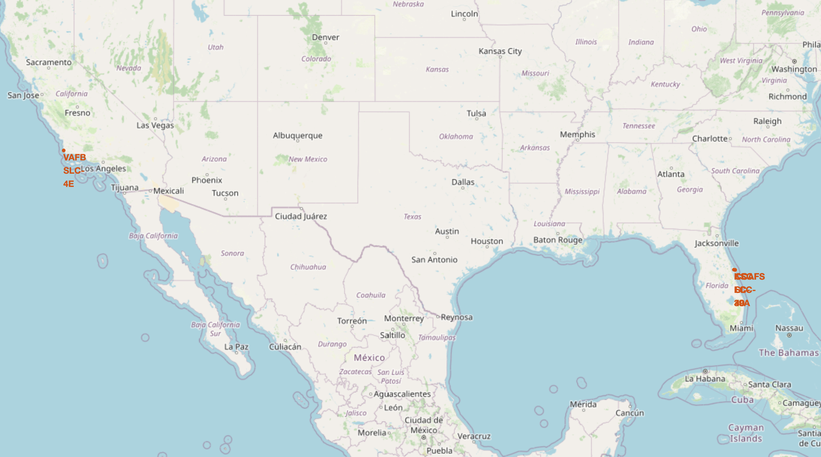
Locations of Launch Sites on Maps
Three in the east
One in the west
All in the south
Launch Site | Lat | Long
CCAFS LC-40 | 28.56230197 | -80.57735648
CCAFS SLC-40 | 28.56319718 | -80.57682003
KSC LC-39A | 28.57325457 | -80.64689529
VAFB SLC-4E | 34.63283416 | -120.6107455
Notes:
Replace <Folium map screenshot 1> title with an appropriate title
Explore the generated folium map and make a proper screenshot to include all launch sites’ location markers on a global map
Explain the important elements and findings on the screenshot

Slide 36
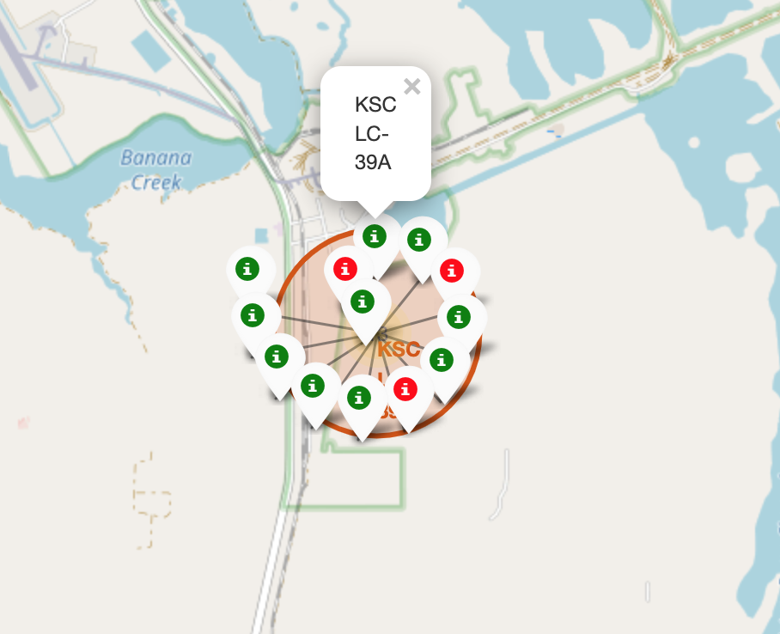
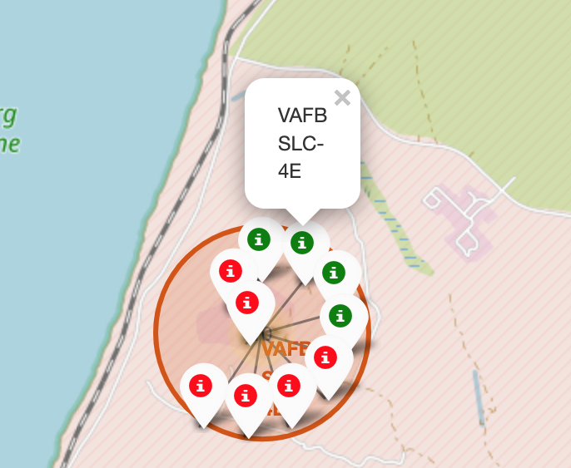
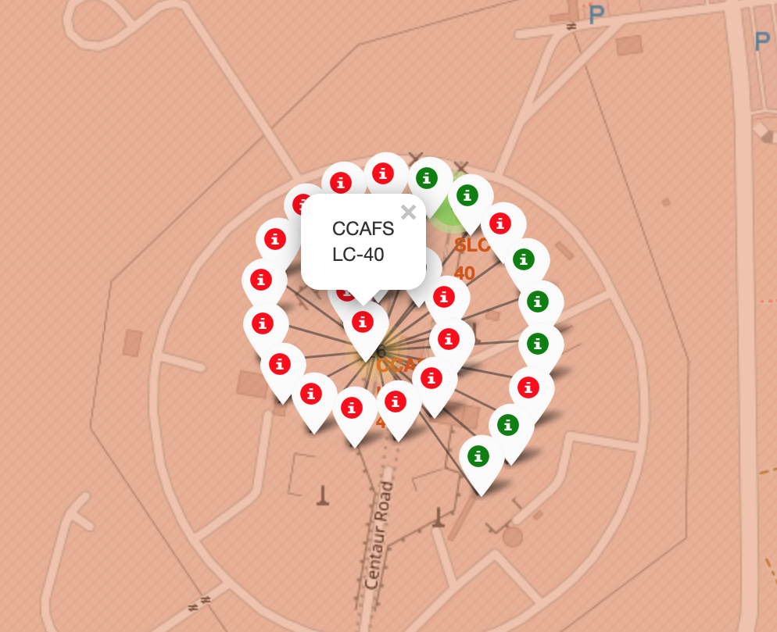
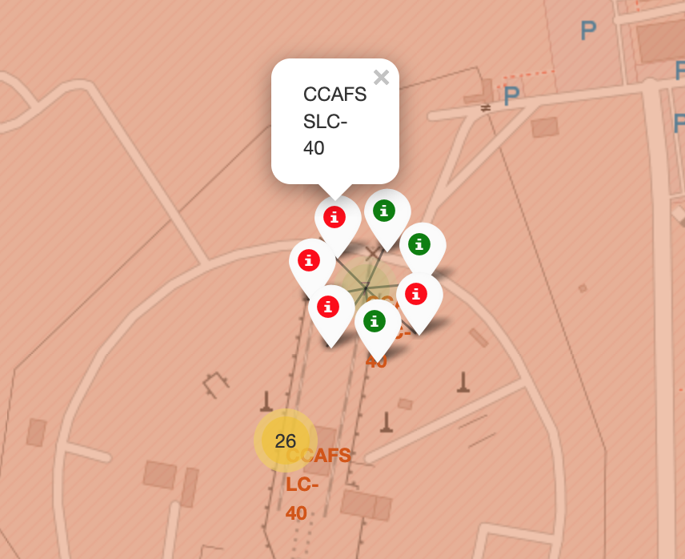
Display Launch Outcome by Color
From the color labels, we can easily see
KSC LC-39A has a rather higher success rate
Whereas CCAFS LC-40 and CCAFS SLC-40 have much lower rate
Notes:
Replace <Folium map screenshot 2> title with an appropriate title
Explore the folium map and make a proper screenshot to show the color-labeled launch outcomes on the map
Explain the important elements and findings on the screenshot

Slide 37
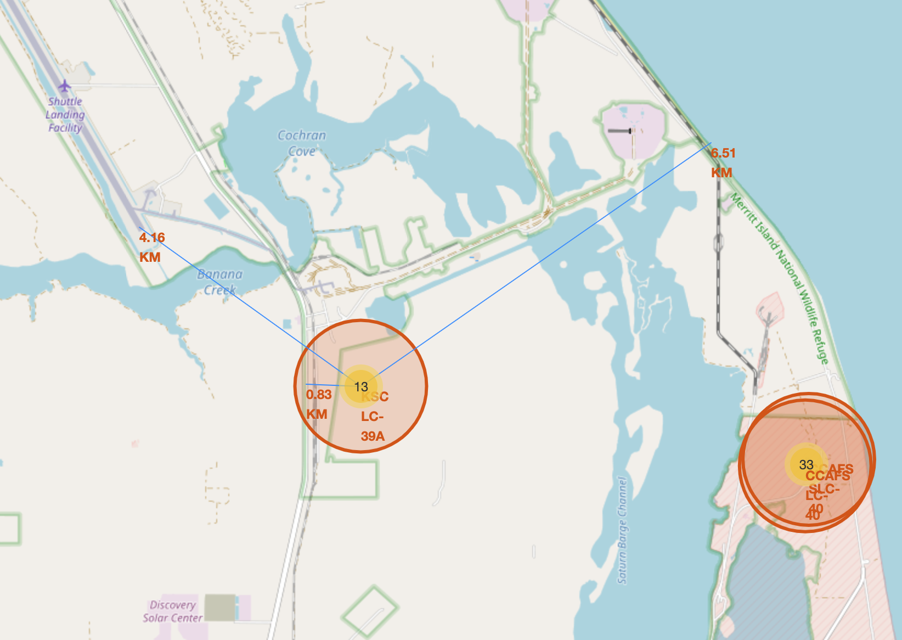
Show Distance to Proximities
The distance from KSC LC-39A to the nearest shuttle landing facility is about 4.16 km.
The distance from KSC LC-39A to the nearest highway is less than 1 km.
The distance from KSC LC-39A to the coastline is around 6.5 km.
Notes:
Replace <Folium map screenshot 3> title with an appropriate title
Explore the generated folium map and show the screenshot of a selected launch site to its proximities such as railway, highway, coastline, with distance calculated and displayed
Explain the important elements and findings on the screenshot

Slide 38

Section 4

Slide 39
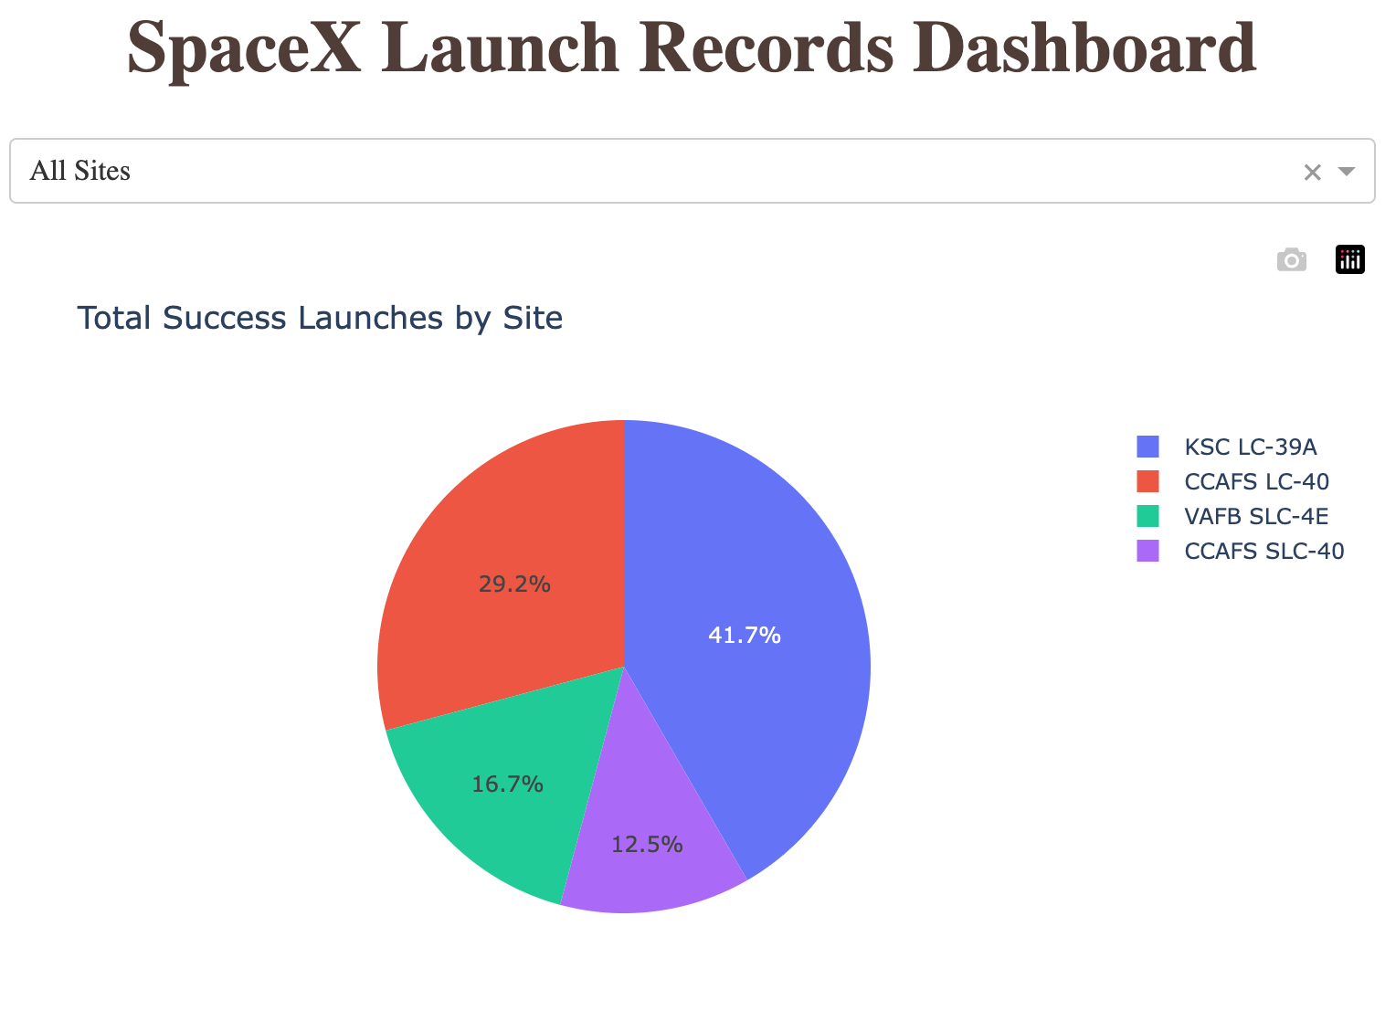
Total Success Launches for All Sites
Total Success Launches for All Sites is
CCAFS LC-40: 29.2%
VAFB SLC-4E: 16.7%
KSC LC-39A: 41.7%
CCAFS SLC-40: 12.5%
Notes:
Replace <Dashboard screenshot 1> title with an appropriate title
Show the screenshot of launch success count for all sites, in a piechart
Explain the important elements and findings on the screenshot

Slide 40
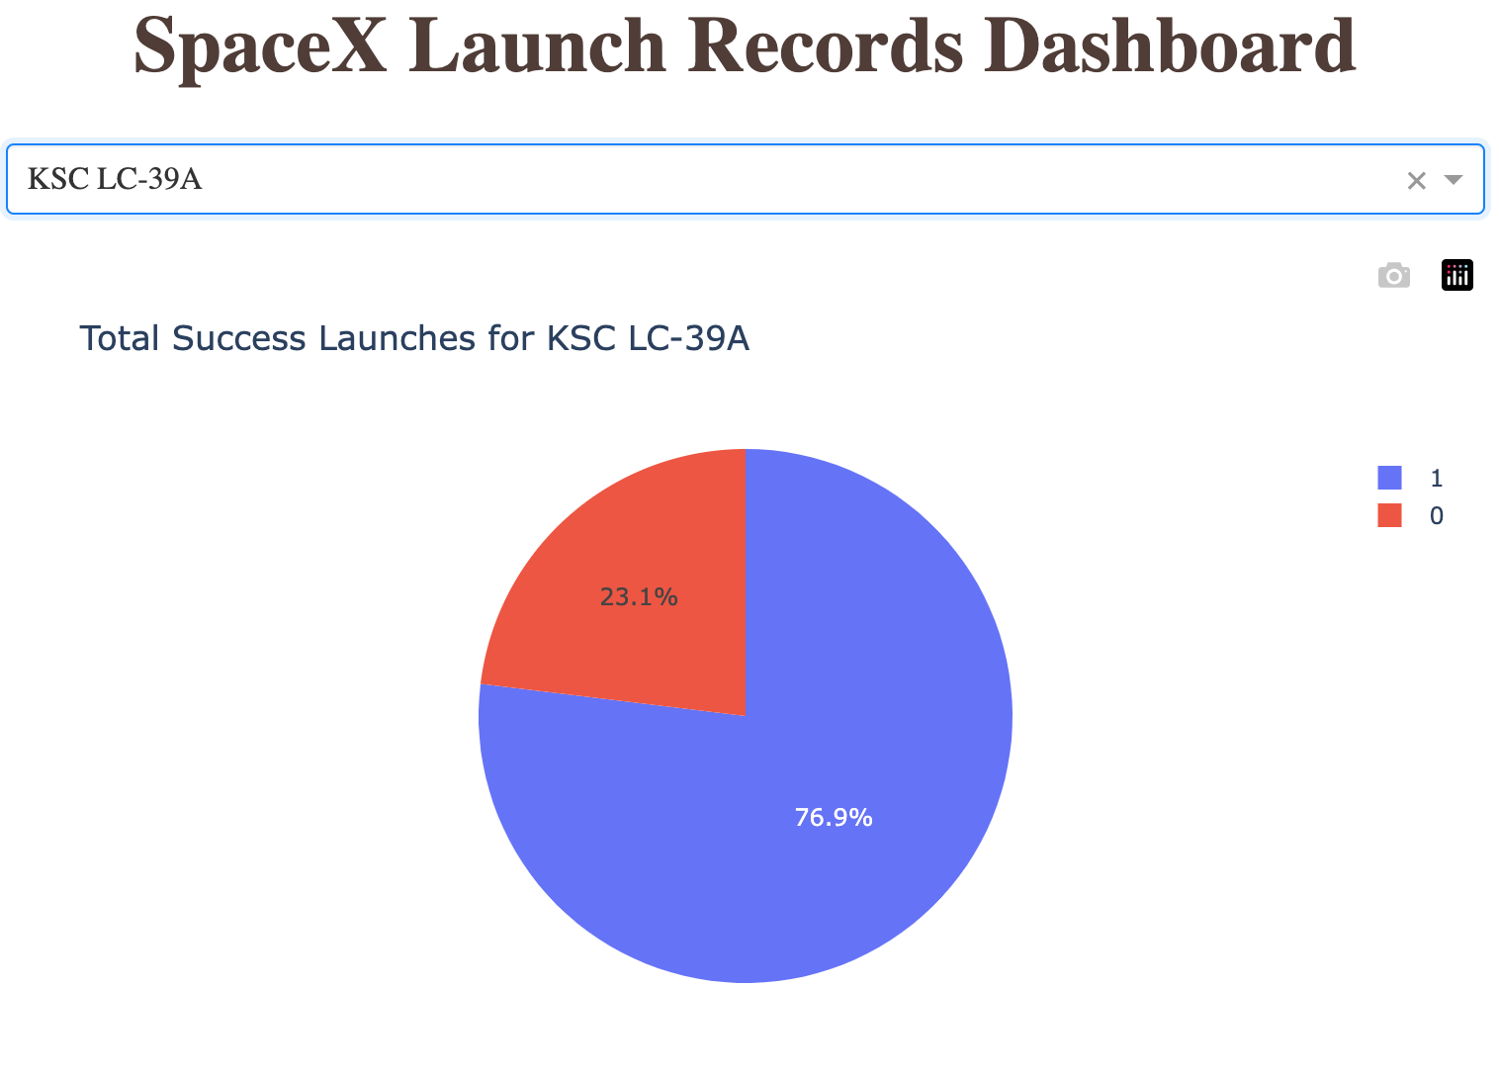
Success Ratio for KSC LC-39A
The launch site with highest launch success ratio is KSC LC-39A.
It has a success rate of 76.9%.
Notes:
Replace <Dashboard screenshot 2> title with an appropriate title
Show the screenshot of the piechart for the launch site with highest launch success ratio
Explain the important elements and findings on the screenshot

Slide 41
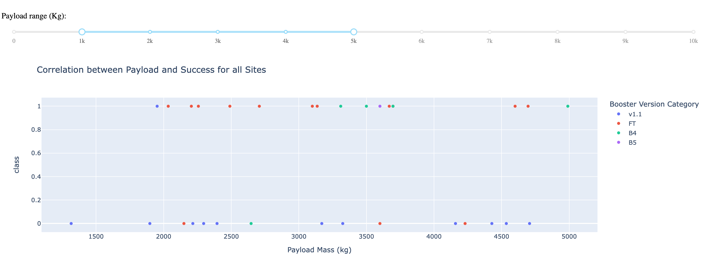
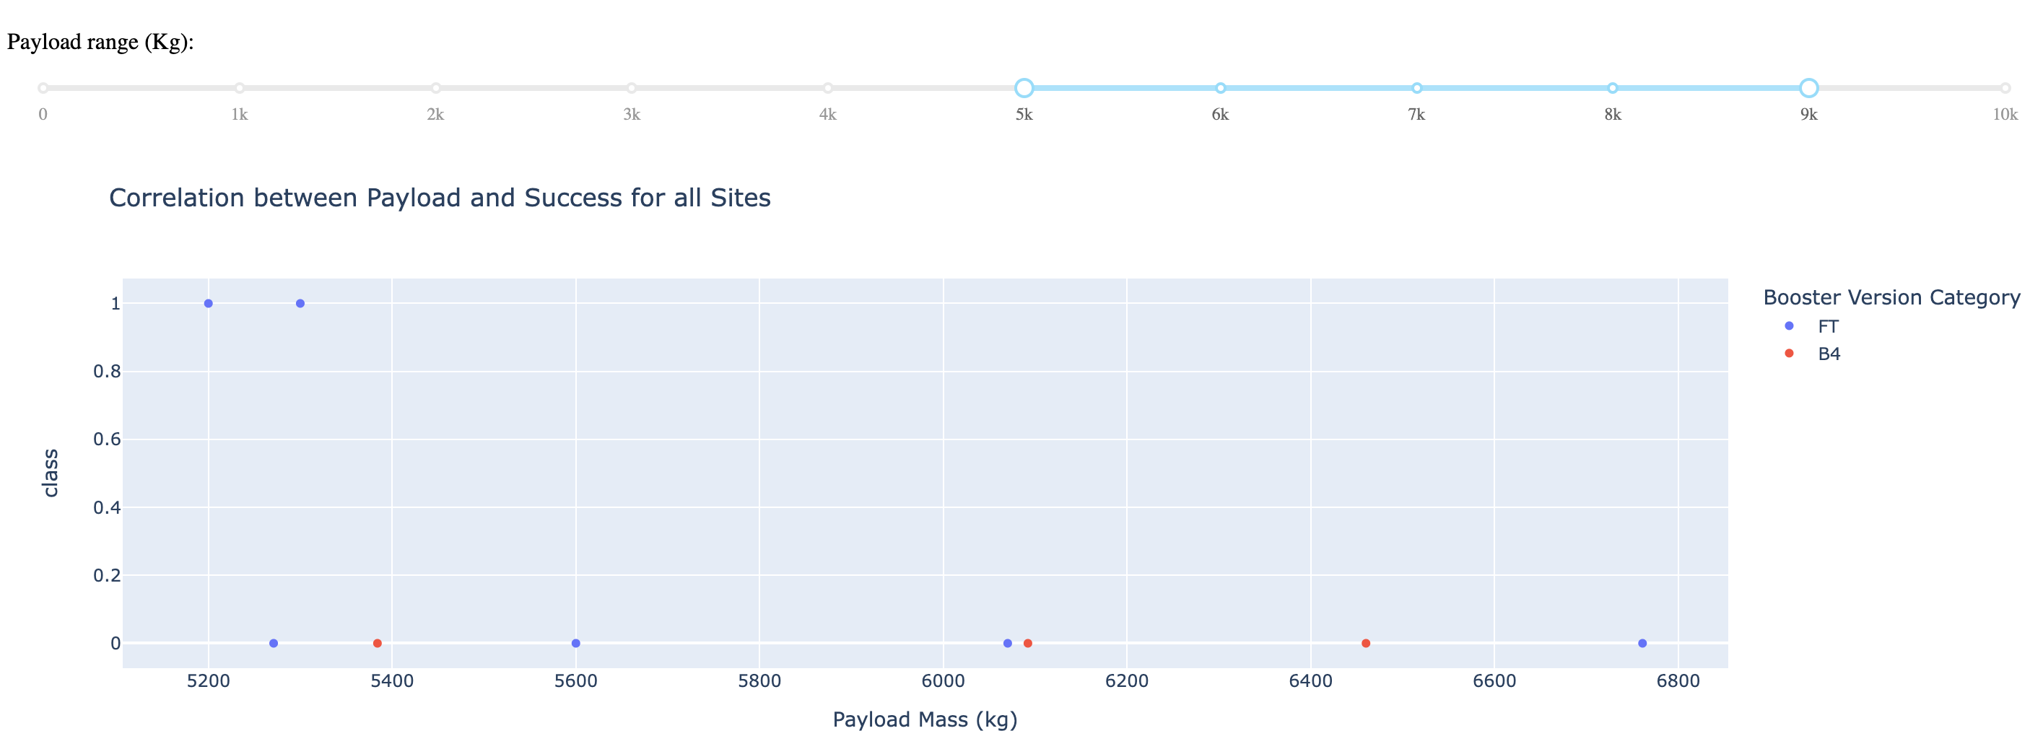
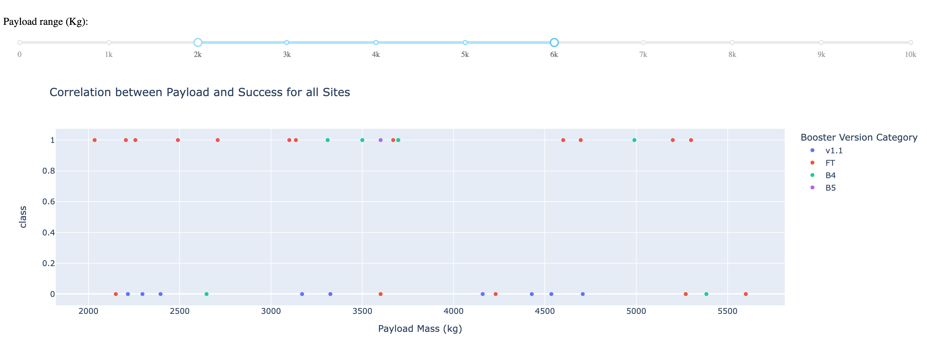
Correlation Between Payload and Success
Payload range in [3000, 4000] has the largest success rate.
Booster version of FT has the largest success rate.
Notes:
Replace <Dashboard screenshot 3> title with an appropriate title
Show screenshots of Payload vs. Launch Outcome scatter plot for all sites, with different payload selected in the range slider
Explain the important elements and findings on the screenshot, such as which payload range or booster version have the largest success rate, etc.

Slide 42

Section 5

Slide 43
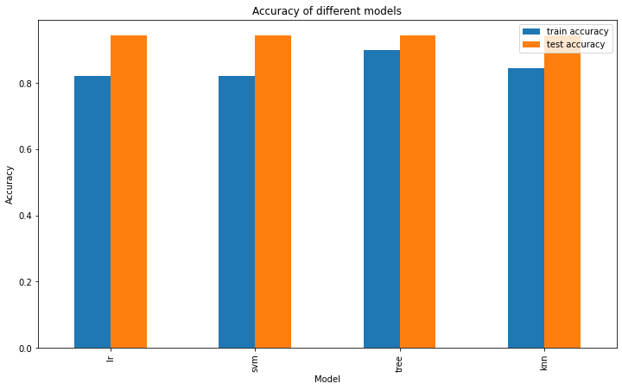
Classification Accuracy
Decision Tree model has the highest classification accuracy
training accuracy 0.9, testing accuracy 0.94
Parameter: {'criterion': 'gini', 'max_depth': 8, 'max_features': 'auto', 'min_samples_leaf': 2, 'min_samples_split': 10, 'splitter': 'random'}
Notes:
Visualize the built model accuracy for all built classification models, in a bar chart
Find which model has the highest classification accuracy

Slide 44
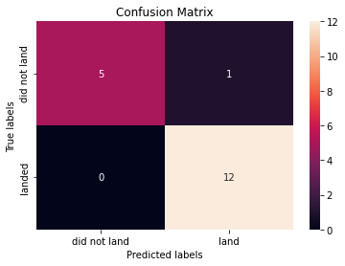
Confusion Matrix
Decision Tree model can distinguish between the different classes.
The major problem is false positives.
Notes:
Show the confusion matrix of the best performing model with an explanation

Slide 45
Conclusions
The dataset has 90 rows of data, with 83 columns. With 80/20 split, we have 72 rows of training data and 18 rows of testing data.
And enhanced by GridSearchCV, we trained four models which have all best performance on test data set.
Of these models, we can choose Decision Tree as our best model for predicting landing outcome of rocket.
By the decision tree, we might have some problem with false positives which probably will impact our estimation of next bid for rocket launch.

Slide 46
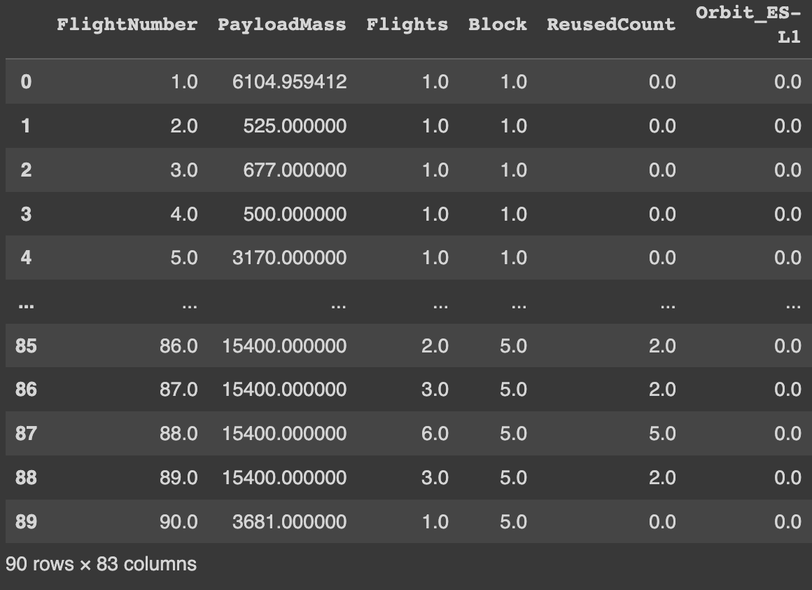
Pitfalls in Model Training
The dataset only has 90 rows of data, but with 83 columns.
With 80/20 split, we only have 72 records of training data.
We have more features than samples! In this case, training model will lead to some unwanted results, such as overfitting.
And we only have 18 test samples. Too few to find out problems.

Slide 47
Pitfalls in Model Training (continued)
How to handle this issue?
Get more data, or add regularization, or dimension reduction
May have a try: since in the EDA we have found some correlation between some variables, maybe we can just get rid of some unimportant columns.
Try PCA to reduce dimension.

Slide 48
Appendix
Share Links:
This Assignment GitHub repository
My Data Science Notes
Other Reference Links:
Test accuracy higher than training. How to interpret?
More features than observations
Notes:
Include any relevant assets like Python code snippets, SQL queries, charts, Notebook outputs, or data sets that you may have created during this project

Slide 49


